Slide 1
Analysis of Social Buzz Data

Slide 2
AGENDA
Project Recap
Problem
Analytics Team
Process
Insights
Summary

Slide 3
PROJECT RECAP
Social Buzz is Technology platform which emphasizes on content by keeping all users anonymous, only tracking user reactions on every piece of content.
It is scaling at very quick pace and hence they need the help of an advisory firm to oversee their scaling process effectively.
To start engagement with Social Buzz, Accenture is running a 3 month initial project in order to prove to them that we are the best firm to work with.
They are expecting the following:
- An audit of their big data practice.
- Recommendations for a successful IPO.
- An analysis of their content categories that highlights the top 5 categories with the largest aggregate popularity.

Slide 4
PROBLEM
Over the past 5 years, Social Buzz has reached over 500 million active users each month.
The amount of data that they create, collect and must analyze is huge.
Every day over 100,000 pieces of content, or 3,65,00,000 pieces per year!!!
With the amount of data generated, it can be used to capitalize more users and also to keep existing users more intrigued on the platform.
So, we analyse the data and find the Category wise distribution of the user engagement on the platform also showing Top 5 Categories in the process.

Slide 5
ANALYTICS TEAM
Andrew Fleming, Chief Technology Architect.
Marcus Rompton, Senior Principal.
Abhishek Ladha, Data Analyst.

Slide 6
Process
Understanding Data
Data Analysis
Insights
Data Cleaning
Data Modelling

Slide 7
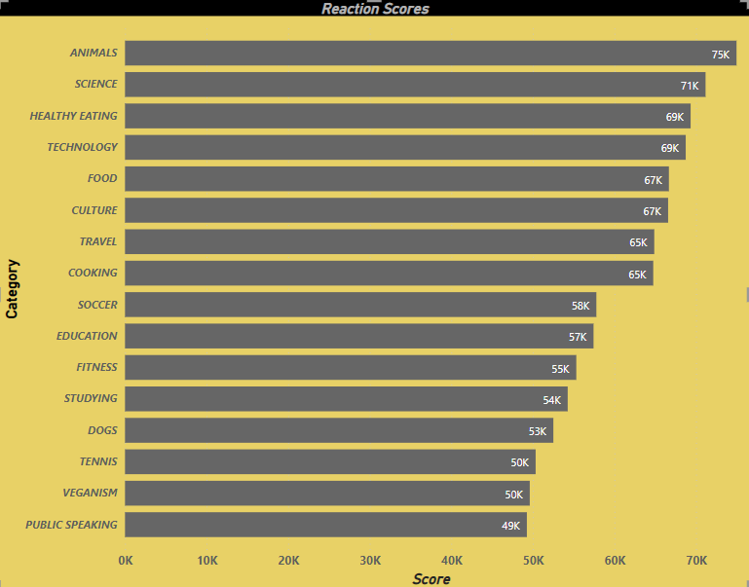
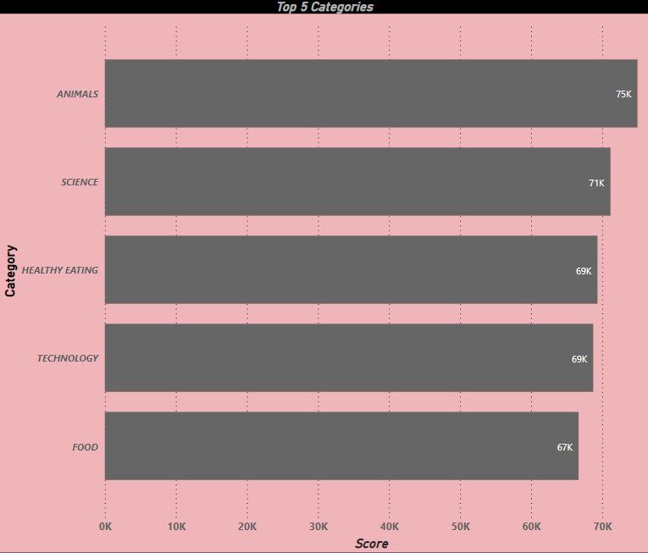
INSIGHTS

Slide 8
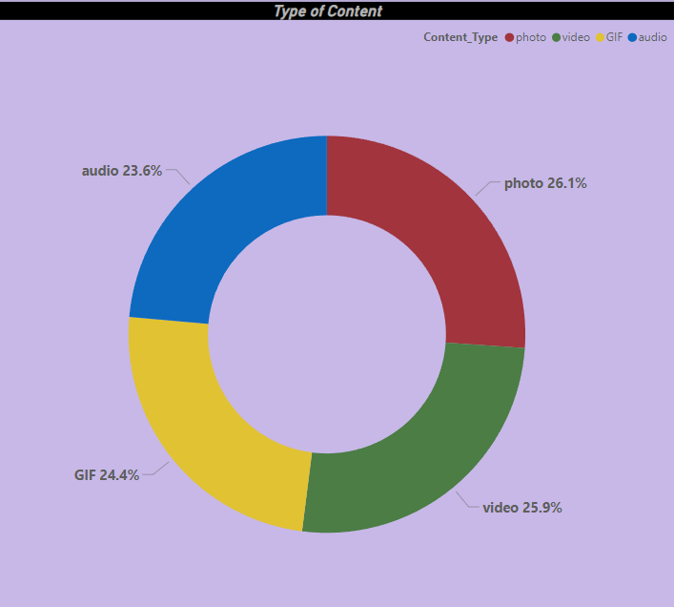
INSIGHTS

Slide 9
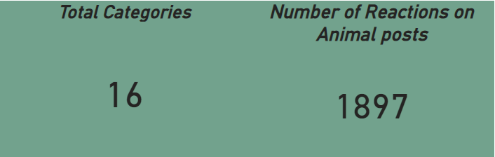
INSIGHTS

Slide 10
SUMMARY
“Animals” and “Science” are most popular content on the platform according to data. People enjoy contented related to life and facts.
Food is very common with 2 categories in the Top 5, in this, “Healthy eating” is ranking the Highest in food categories. This insights can be used to start some campaigns on platform which can promote healthy foods which in turn can get more user interactions.
The platform has wide variety of categories but needs to merge some categories like “Tennis” and “Soccer” can be added under one single category of sports with further subcategories. Similarly, “Dog” can be Merged with “Animals”.
This was an insightful analysis of the user interaction with the content on the platform. We intend to take further analysis of the large scale data with real time to understand your business more clearly.

Slide 11
THANK YOU…
(Any Questions?...)

